Slide 1
Lessons learned from Using Cardiac Arrest Data
Robert B Dunne MD FAEMS, FACEP
EMS Program Director, Professor
Wayne State University
Medical Director, DEMCA
Vice Chair St John Hospital and Medical Center

Slide 2

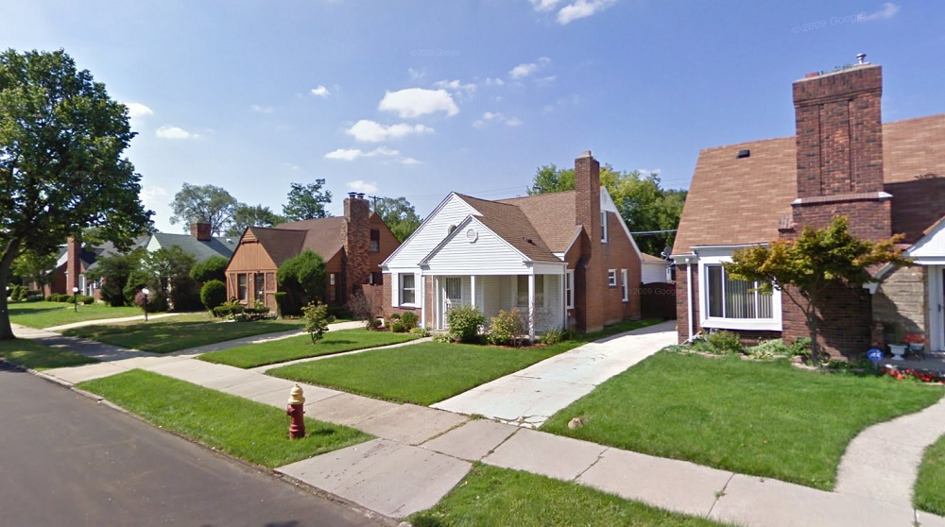
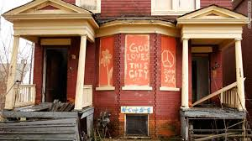
142.87 square miles of which 138.75 sq mi land and 4.12 sq mi water
350 EMS Calls/day

Slide 3
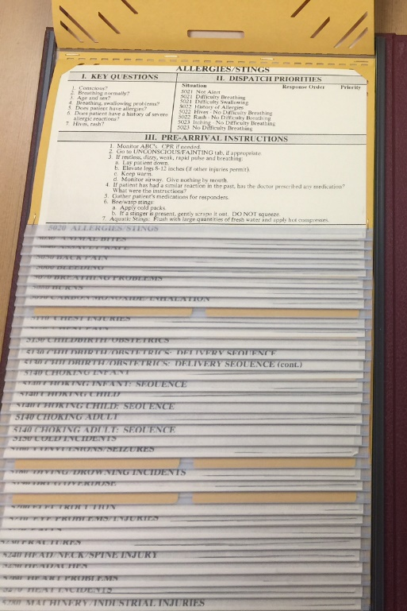
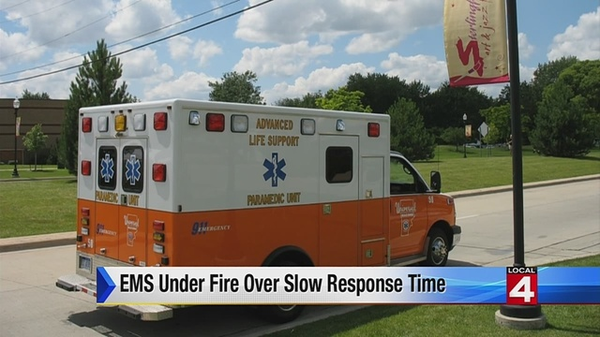
Fire Department 2011
6-10 Functioning EMS units/ No MFR
Broken fire apparatus
EMS and Fire single role
No formal relation with private EMS
No units available every day
No dispatch system – few trained call takers
Times Vague 20-25 min
Paper records
Cardiac Arrest 0.7%

Slide 4
DFD Today
Bankruptcy ENDED 12-2014
Hiring 150 firefighter under FEMA funding
Fire MFR rollout started 4/2015 – whole city
MFR- All engines and squads
MFR reflex 6.3, total 8.56
DEMS 9 ALS units, 24 BLS
Private 8-12 hour units and 4-4hour units MOU

Slide 5
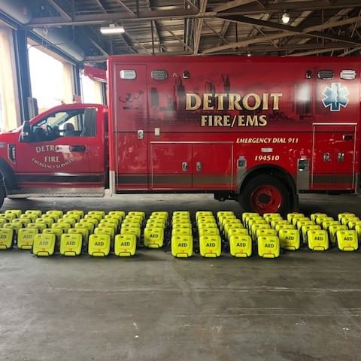
DFD Today
Pro QA, MPD, Weekly review, CPR inst – started 7/15
Accredited training center 1st time since 2008
Frequent user tracking- field referrals
Scheduled vehicle replacements occurring
Updated all transport Monitors 12/2017
New AED deployment pending
CPR data review
New PEER review
DATA, Research Committee

Slide 6
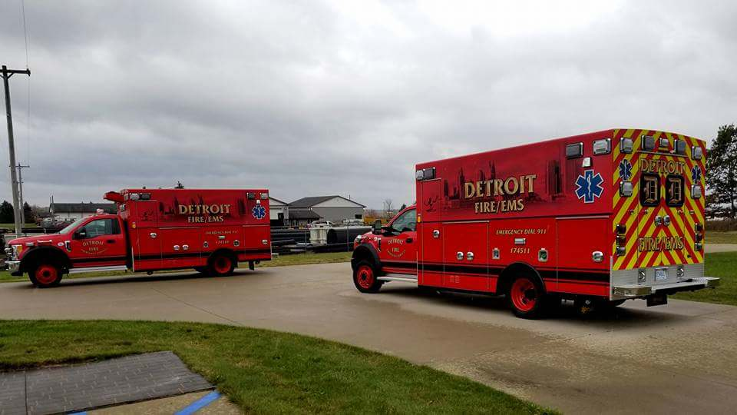
Having BLS do More
Newer BLS protocols
    ALS MONITORS ON BLS TRUCKS
    12 LEAD
    CPAP
    ETCO2
    BLS Termination
  FUTURE?
    Telemetry
    Tele Presence

Slide 7
Optimizing the System of Care
Track DATA - CARES registry
DETROIT – non traumatic CPR cases
2005 <0.2 % Survival to DC
2014 – 3.6%
2015 – 5.4%
2016 – 6.4%
2017 – 7.0%
2018 – 4.8%
2019 – 5.2%
Notes:
Thanks to EMS

Slide 8
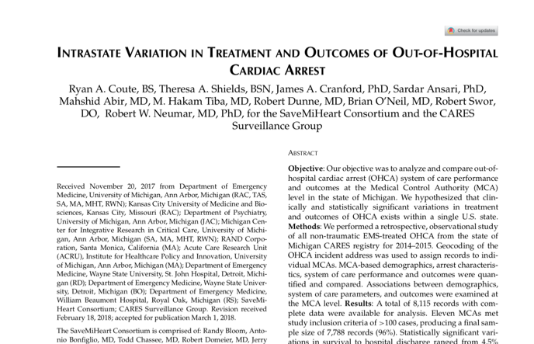
Still A lot of Variability

Slide 9
Geographic Targeting of Citizen CPR

Slide 10
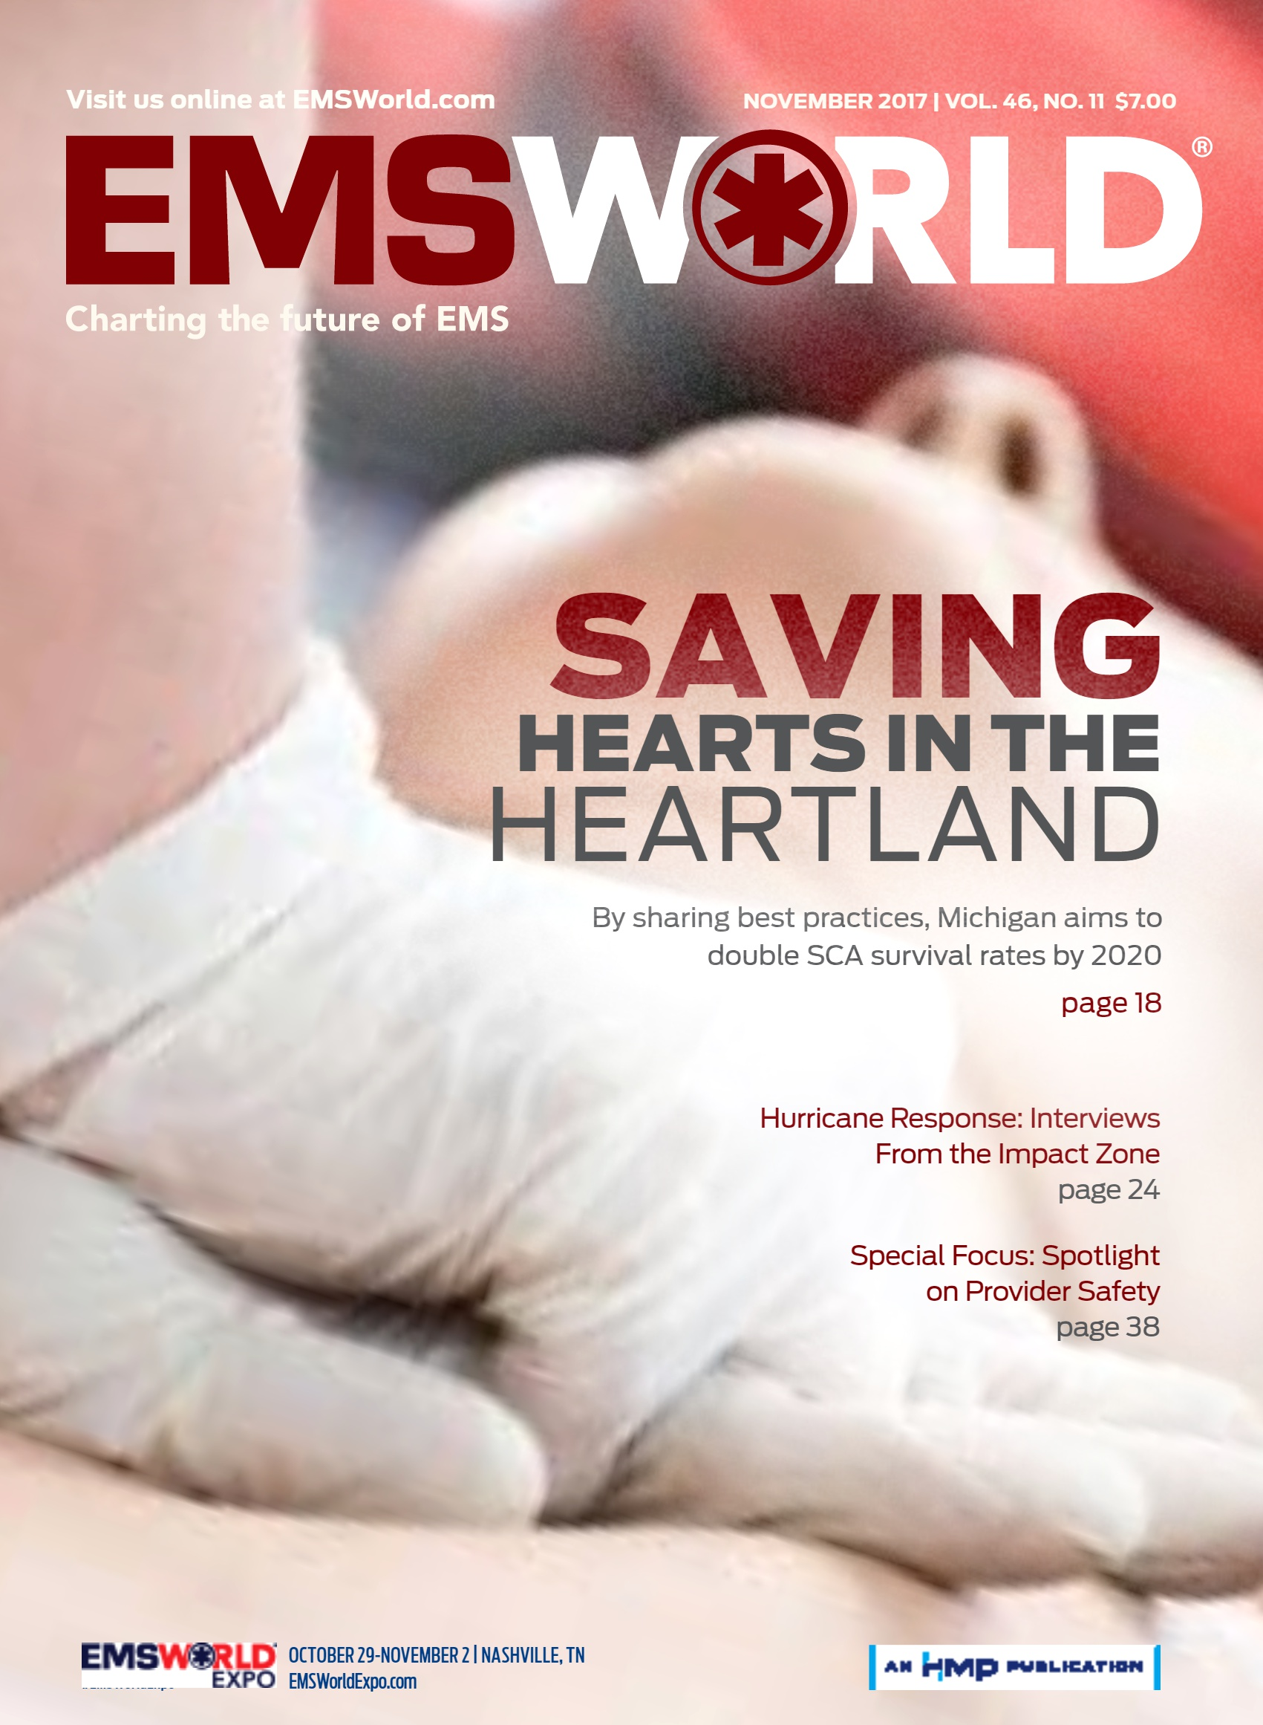
Community/Citizen Response
Culture change: everyone can respond
Metrics:
  Bystander CPR Rate
  Bystander AED Application Rate
Compare to national benchmarks
Set goal for annual increase
Celebrate saves
CPR rate from 14% to 40.1% (2019)
Detroit call takers are big part of this

Slide 11
Ongoing Progress

Slide 12
CPR Quality
Chest Compression CCF >80%
Compression rate of 100 to 120/min
Compression depth of ≥50 mm in adults with no residual leaning
  At least one third the anterior-posterior dimension of the chest in infants and children)
Avoid excessive ventilation
  Only minimal chest rise and a rate of <12 breaths/min
  Watch CO2 waveform
Meaney Circulation 2013

Slide 13
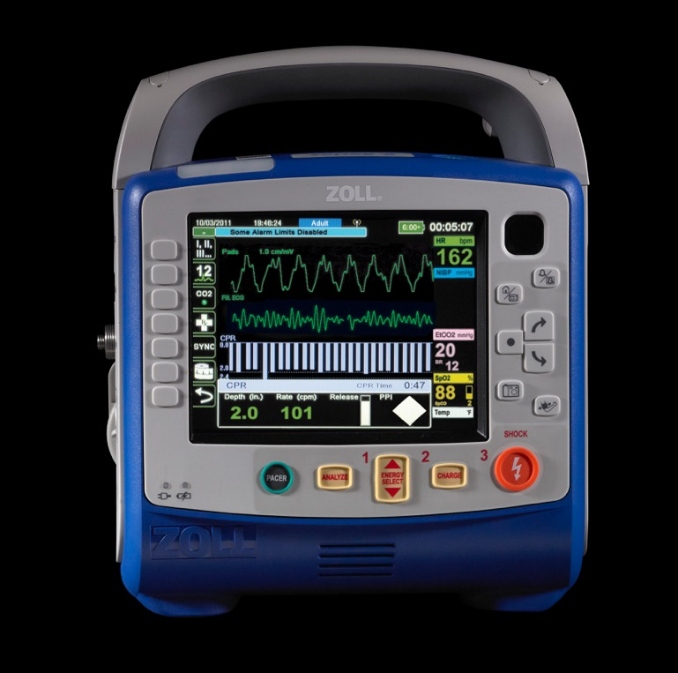
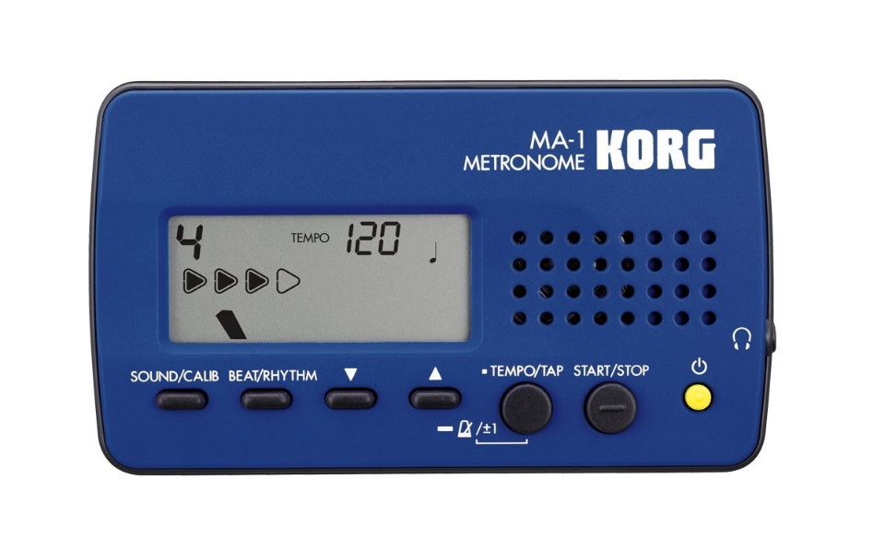
CPR Quality: Live Feedback

Slide 14
CPR Quality: Follow up Feedback
Picture monitor
Feed back report

Slide 15
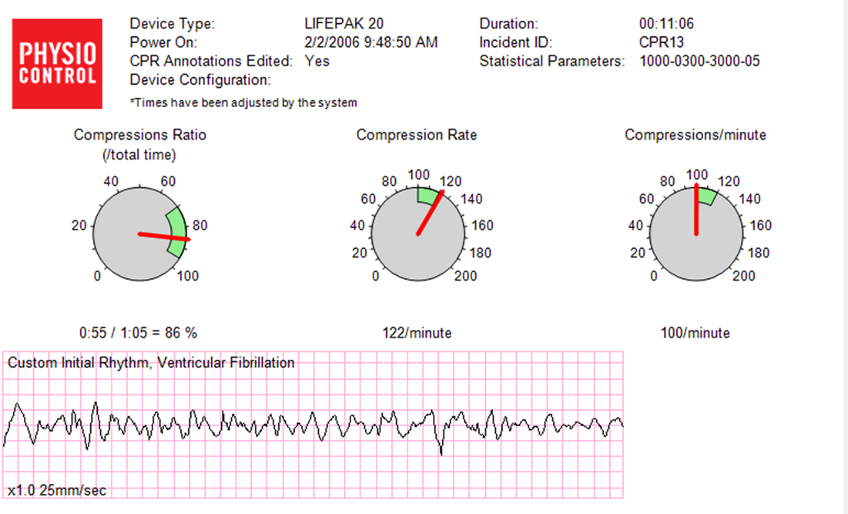
CPR Quality: Follow up Feedback
Picture monitor
Feed back report
Goal 90% CPR fraction

Slide 16
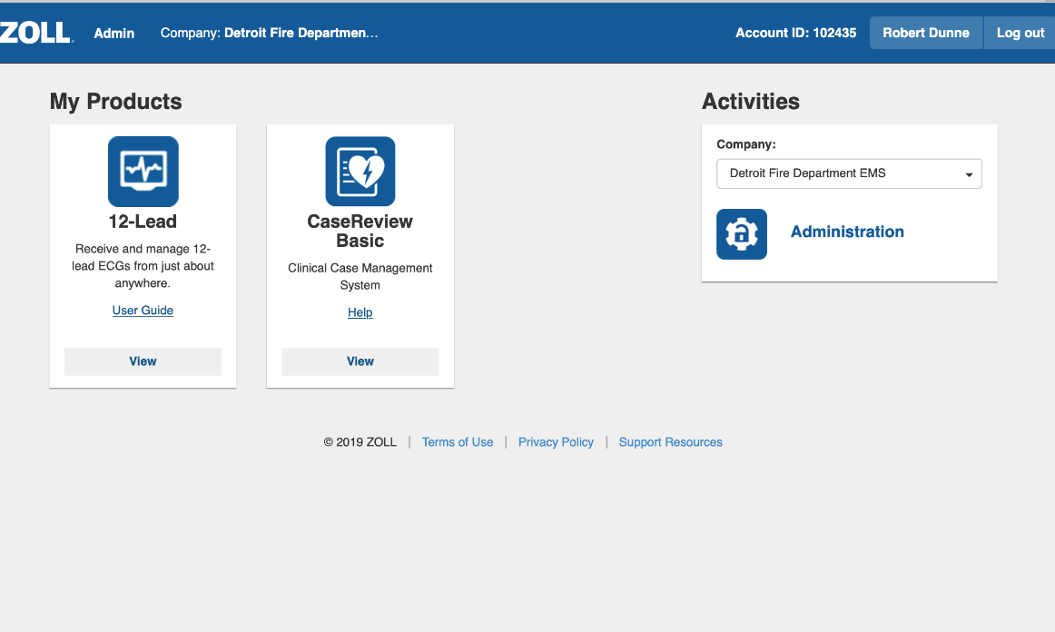
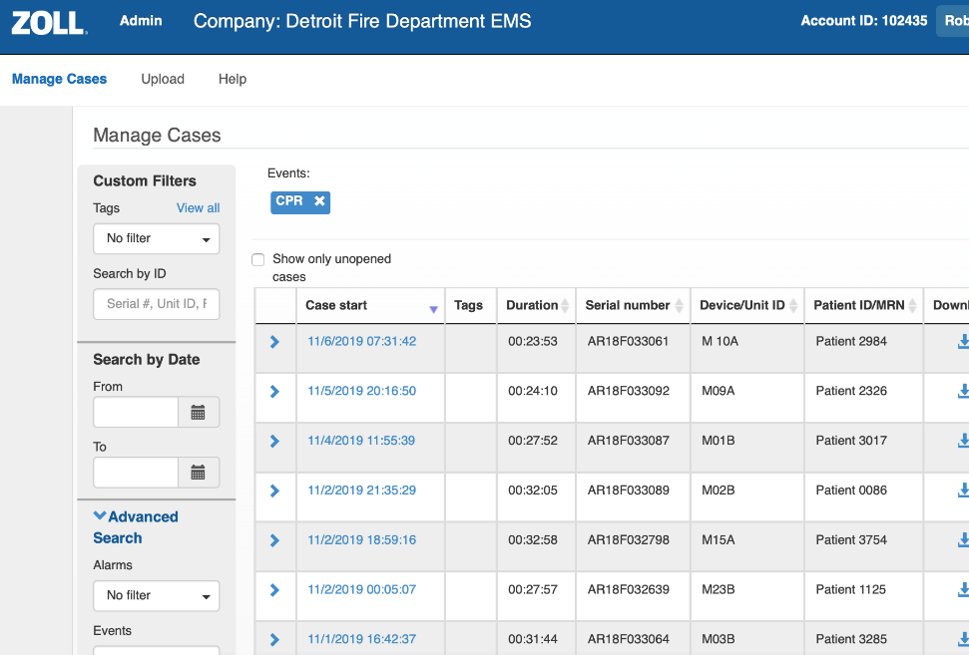
How to– DYI data analysis
Started with older monitors – one at a time
IRDA – AEDs
New Monitors
  Cloud based – 30 days
  Download every week
  Compare to record
BLS considerations
  Actually get know initial rhythm
Non-Transport unit AEDs

Slide 17
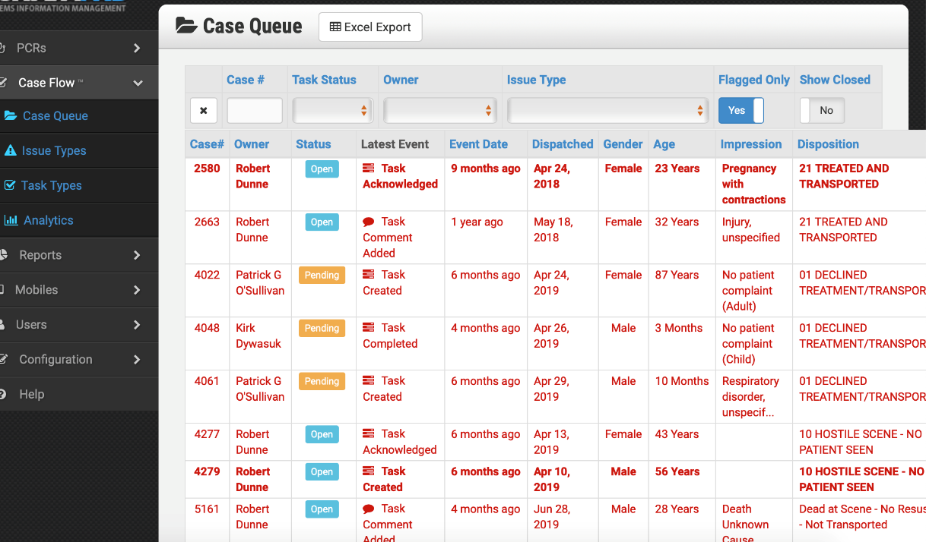
How to– DYI data analysis
Hospital Access to data – why is it important
Monitor Files attached to EMS Records
What we do with these.
TEAM:
  Medical director
  EMS Fellows
  EMS Physicians
  Agency Training
  CARES coordinator
FUTURE
  Real time: supervisors
  Field Team
  Clean Handoff to Hospital

Slide 18
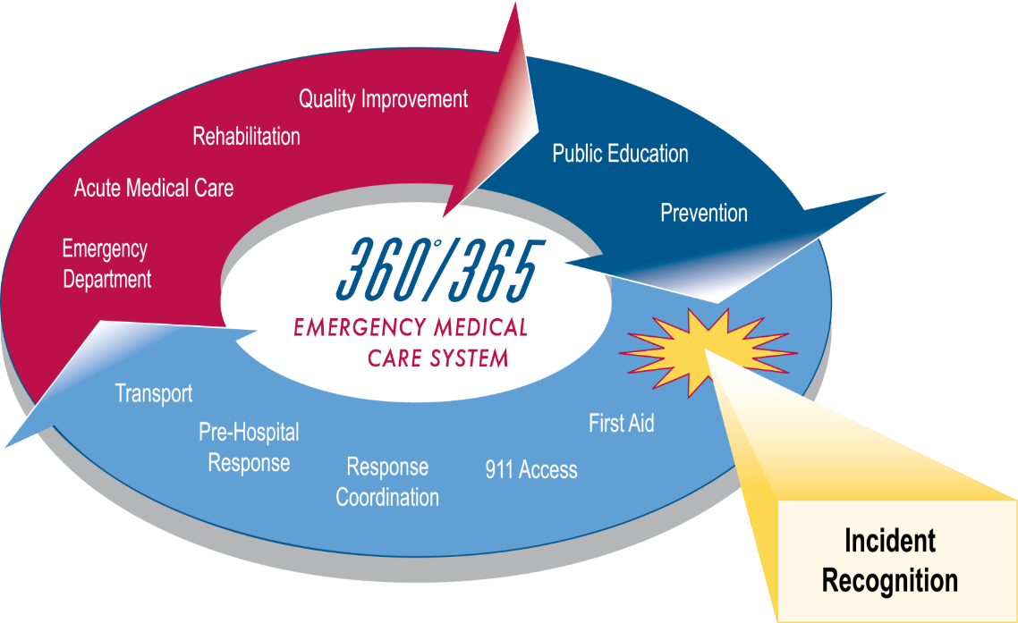
EMS
Code Reviews
CPR quality monitoring
Metrics
  911 call to first shock interval
  CPR performance and physiologic response
  ROSC rate
Compare to national benchmarks
Set goals for annual increase
Update protocols and Education
Celebrate saves
SAME PLAN FOR HOSPITAL – Education

Slide 22
Covid Relevant Timeline
1/23 Update to all providers, many refocus on PPE
2/1 DTW starts as official screening site
  Using “special pathogen” protocols
  Updated education to all providers
2/3 First Health Dept / FD / EM planning meeting.
Health Systems look at in-system screening and assessment
2/28 EOC at State
3/10 First Positive Case
3/11 Colleges announce changes
3/13 Close K-12

Slide 23
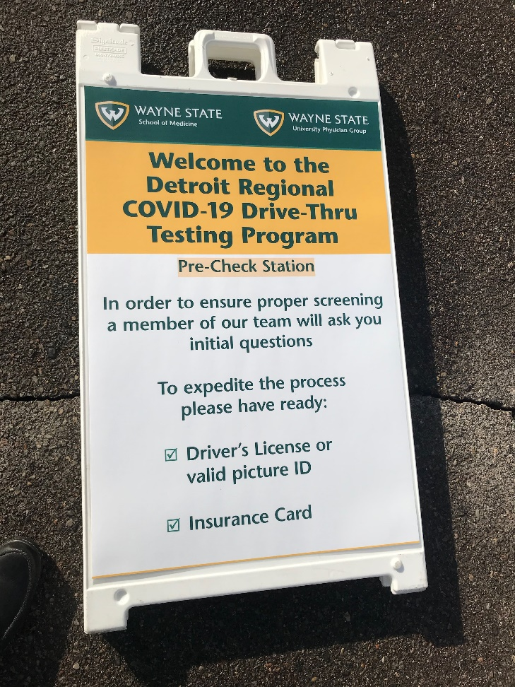
Protocol Updates
Existing special pathogen protocols
911 Changes – EIDS, Location monitoring
3/17 New Protocols
  ET tube, Nebs etc now post radio
  New Sepsis related CPR protocol 10 min to TOR
  Telemedicine protocol (e-Bridge) – low priority
  Workplace monitoring
Re-Iterate hospital status protocols

Slide 25
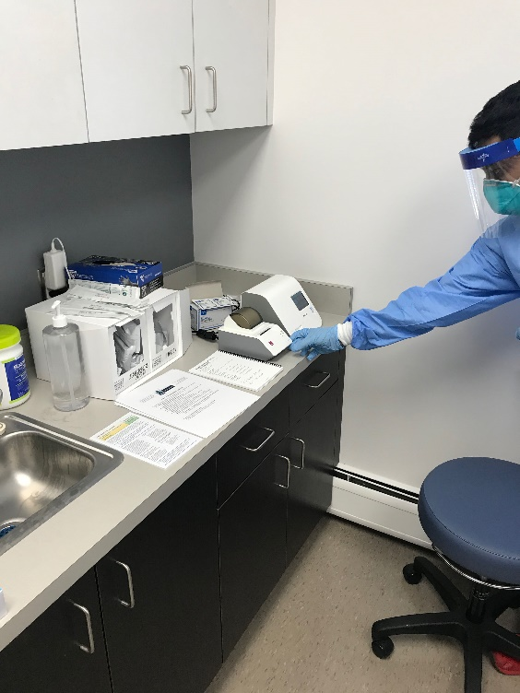
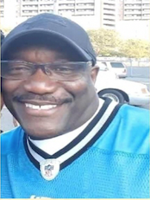
Fire Department Timeline
3/12 – City employee response plan and team. Dedicated testing site (20/day)
3/15 – 1st Detroit EMS exposure “official” exposure notification
3/16 Medical Monitoring in FD/EMS
3/19 – First EMS employee sick, sent for testing
3/24 – First Fire Fighter ill monitored.
3/26 - first positive test (exposed on 3/19)
4/3 – City Starts Abbott Rapid Test (1200/wk)
4/8 Detroit Fire Department Capt. Franklin D. Williams, Jr. Dies
86 total positive in FD as of June 1

Slide 26
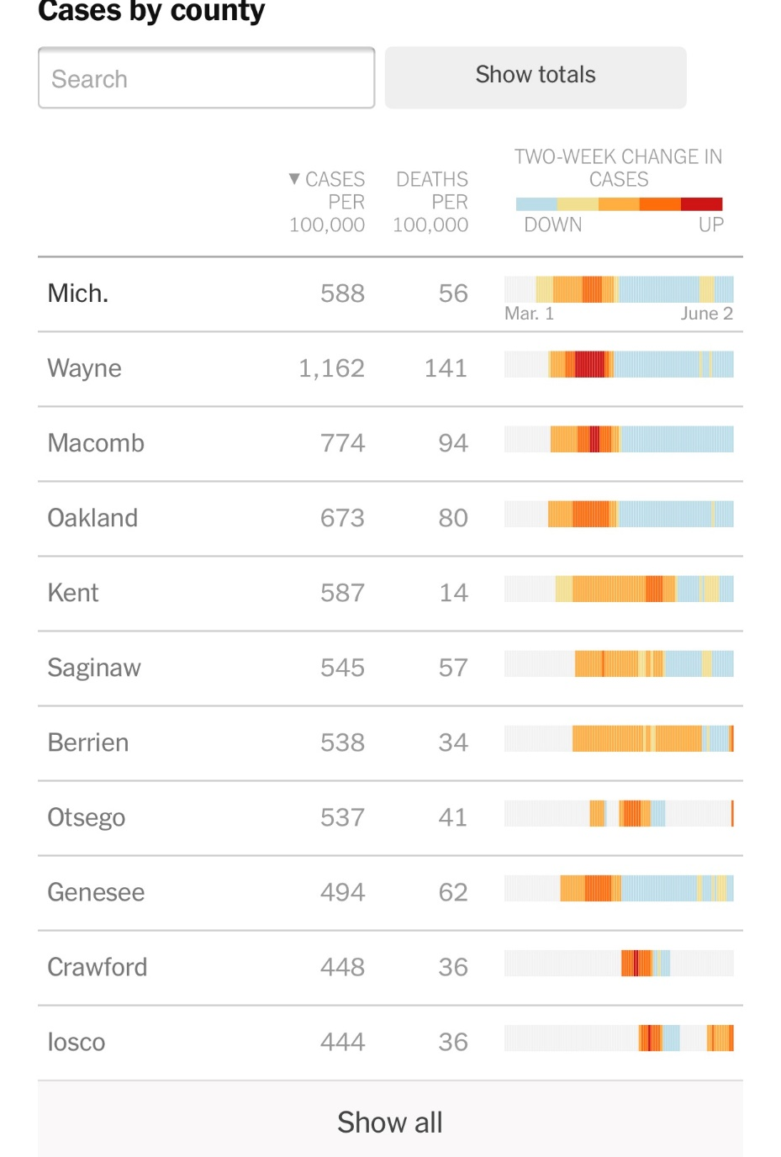
Detroit :
Cases 11280, 1666/100k
Deaths 1409, 208/100k

Slide 27
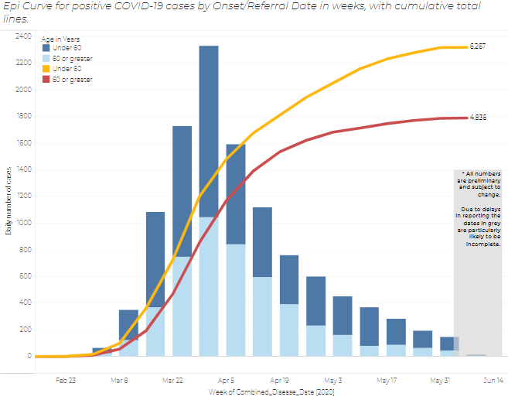
New Cases by Week Reported, by age

Slide 34
On Going Analysis
Visits prior to arrest (49 cases so far)
What is really related to COVID-19?
  How to adjudicate
  What about those found dead
  Linkage to testing data
  Death Certificates
CPR quality
Waveform Capnography
Attitudes of the responders

Slide 35
Hospital Intervention post OHCA (2014-2019)

Slide 36
Hospital Interventions Update

Slide 37
Hospital A

Slide 38
Hospital B

Slide 39
Hospital C

Slide 40
Education of Hospitals

Slide 41
SUMMARY
USE your data
CARES follow ups
QA every case
USE monitor and AED data
Partner to support physician response programs
Advocate for patients
Teach the community
Celebrate saves
Keep up with the science
Despite COVID The Golden age of cardiac arrest research is now

Slide 42
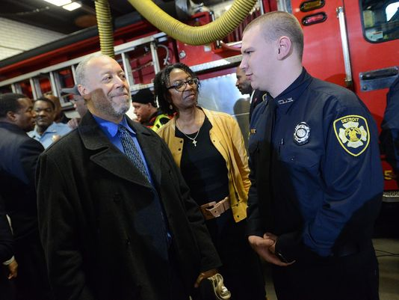
KEEP UP THE GOOD WORK
Notes:
The city’s firefighters are now cross-trained for emergency medical runs and John Samuels Jr. says he’s alive today because of it.
Samuels went into cardiac arrest while napping on the couch of his Detroit home after church on Christmas Day. Soon after, a 911 operator directed his wife to administer CPR and a life-saving team of emergency medical technicians and firefighter first responders took it from there.
“I never thought it would be me as a recipient of it,” said Samuels, a 59-year-old electrician who is trained in CPR. “Now I know what CPR can do. It worked for me.”
Samuels detailed the efforts that saved his life during a Thursday news conference with Mayor Mike Duggan and Detroit fire officials marking the completion of a two-year process that has all of Detroit’s 871 fire personnel trained to handle medical runs.
Detroit launched the mandatory Medical First Responder program in 2014. Before then, Detroit was one of the only major fire departments in the country without cross-trained firefighters.

