Slide 1


Slide 2
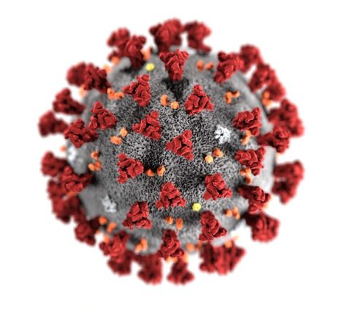
Seattle and King County, WA Resuscitation in the Era of COVID-19
Thomas Rea MD MPH
Medical Director - King County EMS
University of Washington
Michael Sayre MD
Medical Director - Seattle Fire
University of Washington

Slide 3
Outline
1. In the beginning…..first few days
2. Critical structure and strategies
3. Healthcare worker safety
4. Monitoring the system
5. Resuscitation

Slide 4
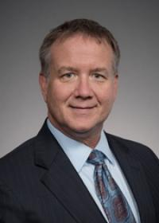
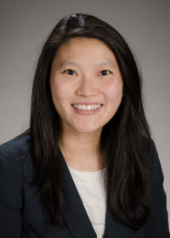

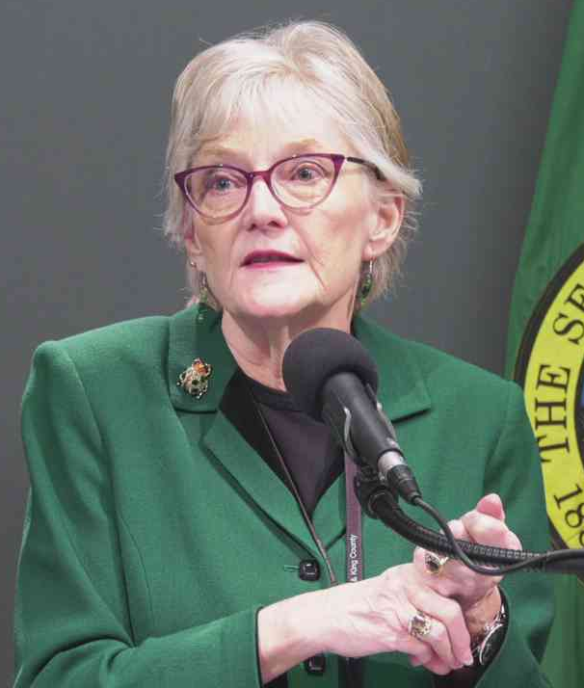
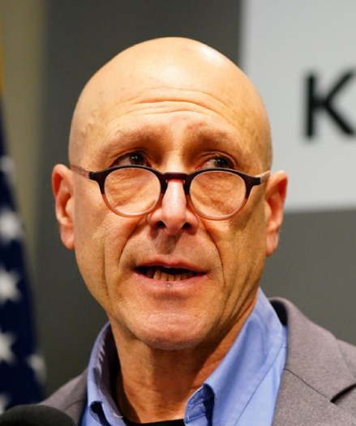

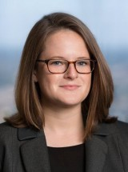
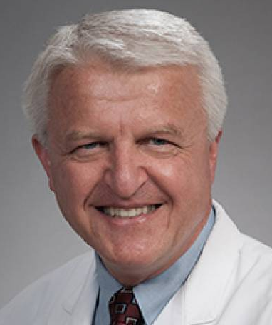
Medical Leadership
Michael Sayre
Betty Yang
David Murphy
Patty Hayes
Jeff Duchin
Mickey Eisenberg
Catherine Counts
Peter Kudenchuk

Slide 5
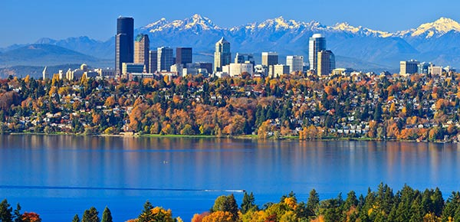
King County
2200 Square Miles
2.2 million persons
12 communities >50K
EMS System
Administered by Public Health
27 Fire Departments, 2-tier response
4 Communication Centers
12 Primary Receiving Hospitals

Slide 6

Morning of February 28
A Pandemic

Slide 7
February 27: CDC COVID-19 Criteria
2019-nCoV Identification Algorithm
Clinical Features | & | Epidemiologic Risk
Fever and symptoms of lower respiratory illness (e.g., cough, difficulty breathing) | AND | In the last 14 days before symptom onset, a history of travel in Asia, Italy, or Iran. – or – In the last 14 days before symptom onset, contact with a person who is under investigation or confirmed COVID-19 infection
Or unexplained severe lung illness

Slide 8

Friday Evening, February 28
8:30 pm: Evergreen Medical Center calls to determine if EMS was involved in care of 2 patients just diagnosed with coronavirus.

Slide 9
Overnight
Identify responding EMS agencies. Contact leadership.
Activate Kirkland EOC
Update status of location to full PPE for all calls (Norcom)
Identify all calls for EMS (public and private) over the past 2 weeks.
Generate list of all employees and their contacts linked to patient exposure
Quarantine EMS involved in any call at the facility for the prior 2 weeks

Slide 10

Monday March 1: 20 cases, 8 deaths

Slide 11
Critical Structure and Strategies

Slide 12


Network for communication
Case Surveillance (who, where, when, how)
Death Investigation (who, where, when, how)
Contract Tracing
Longterm Care Facilities
Shelters and Homeless Care
Hospital Capacity
Testing, testing, testing
Worker Safety
PPE inventory, use, and distribution

Slide 13
Understanding Epidemiology

Slide 14
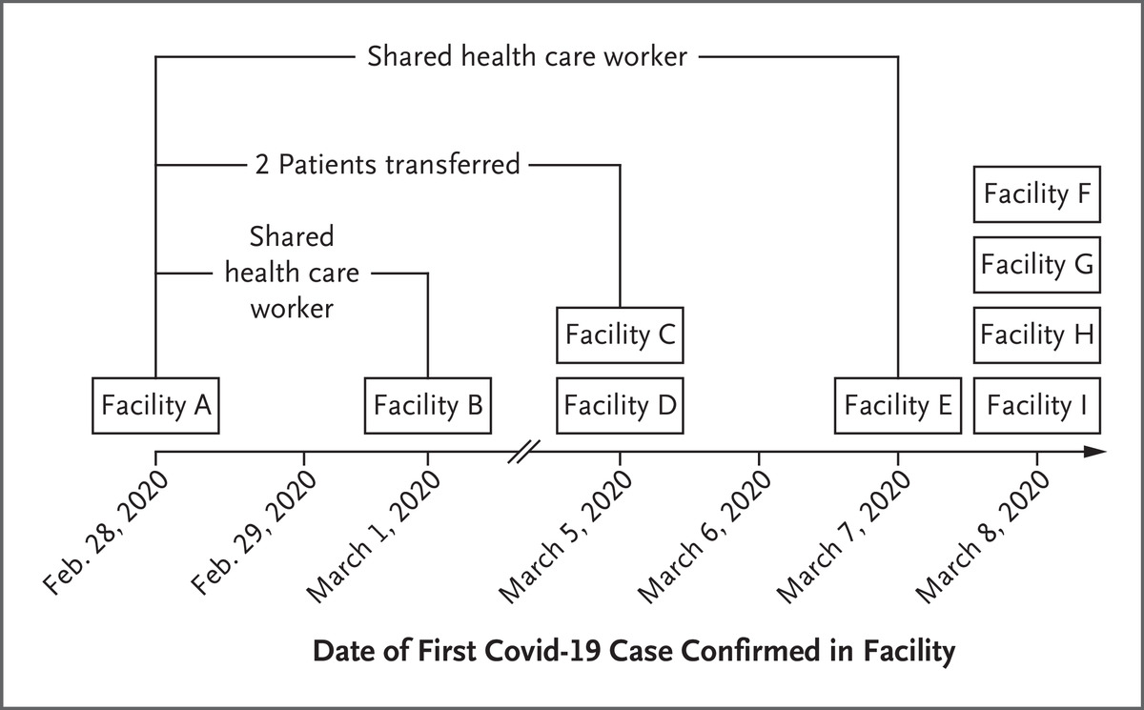

TM McMichael et al. N Engl J Med 2020. DOI: 10.1056/NEJMoa2005412
Timeline Showing Long-Term Care Facilities in King County with One or More Confirmed Cases of COVID-19.
Spread of COVID-19 Through SNF
Notes:
Figure 2. Timeline Showing Long-Term Care Facilities in King County with One or More Confirmed Cases of COVID-19. The first nine long-term care facilities (e.g., nursing homes or assisted living facilities) in King County with one or more confirmed cases of Covid-19 are shown according to the date of the first confirmed case. Facilities are those identified as of March 9, 2020. The direction of potential introduction of Covid-19 from one facility to another is unknown.

Slide 15
Healthcare Worker Safety

Slide 16
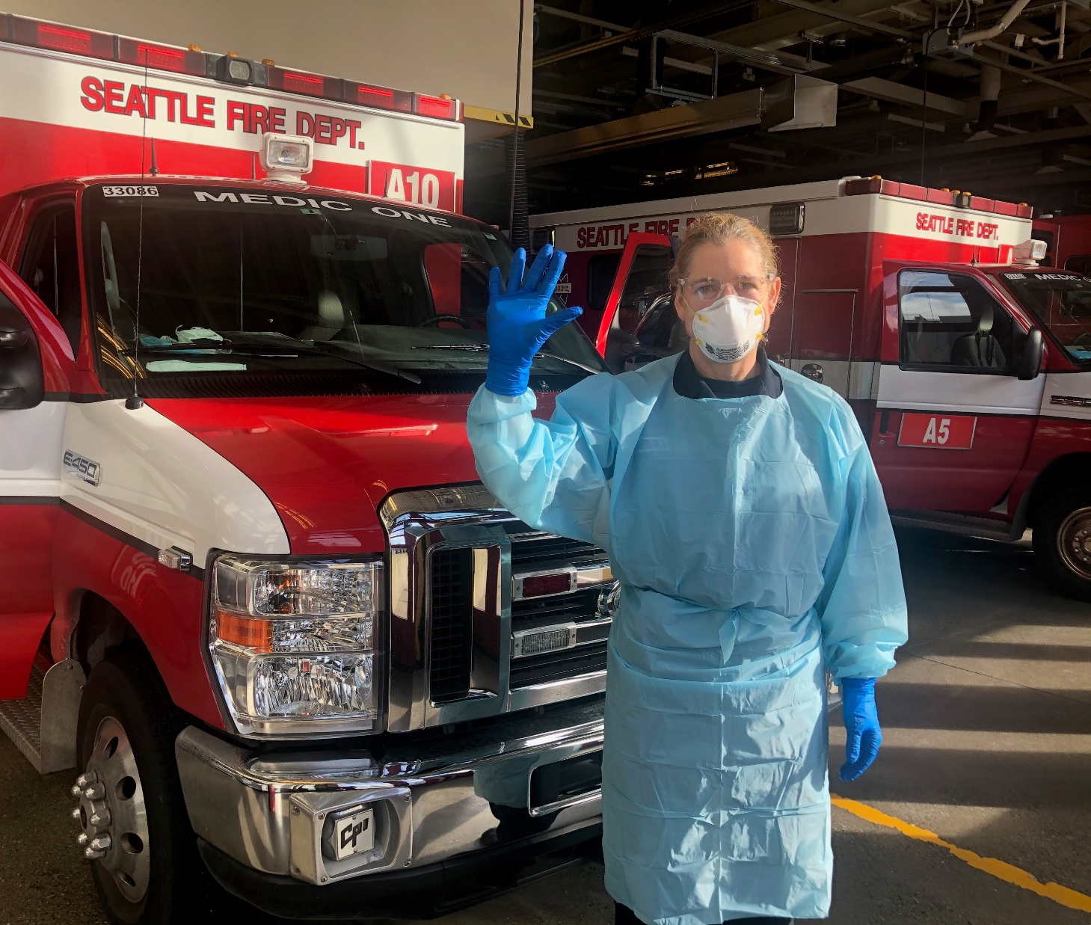
Safety for Public Safety
Strategies for:
EMS Call Response
Case Detection & Surveillance
Exposure, Quarantine, & Isolation
Wellness & Testing
Notes:
Retrained ENTIRE workforce in PPE and updated n-95 fit testing

Slide 17

Link between EMS Encounters and COVID Surveillance
Electronic EMS Record
EMS Providers
DOH COVID Surveillance

Slide 18
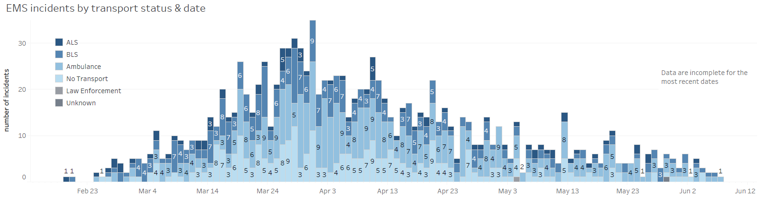
EMS Encounter with COVID Patients

Slide 19
Challenges of Field Identification
Dispatch Code, %
Illness of Unknown Origin | 28%
Difficulty Breathing | 25%
Trauma | 15%
Infectious Disease | 13%
Cardiac | 10%
Bleeding/Pain | 5%
Stroke/Headache | 4%
Documented Symptoms, %
Fever, Cough or SOB | 71
Cough | 29
Fever | 46
Shortness of Breath | 44
Fatigue | 40%
Altered Mental Status | 28%
Nausea/vomiting/diarrhea | 15%
Abnormal Vital Signs, %
Temperature ≥ 38°C | 51%
Respiratory Rate ≥ 24 | 32%
O2 sat. ≤ 92% | 54
Heart Rate ≥ 100 bpm | 34%
GCS < 15 | 27%
SBP ≤ 90 | 12%
Acute febrile respiratory illness does not adequately identify COVID-19 illness

Slide 20
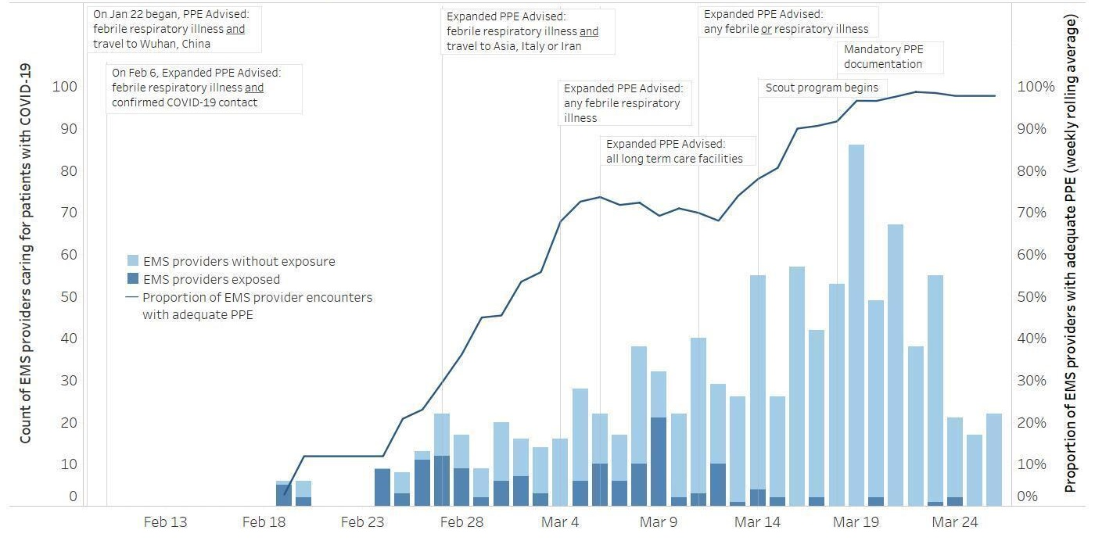
Occupational Exposures and PPE use among EMS Providers caring for COVID-19 Patients, Seattle & King County through March 26, 2020
-Expansion of qualifying risk (location) and symptoms
-Engagement of 9-1-1 Dispatch
-Scout technique for initial assessment

Slide 21
EMS Wellness

Slide 22
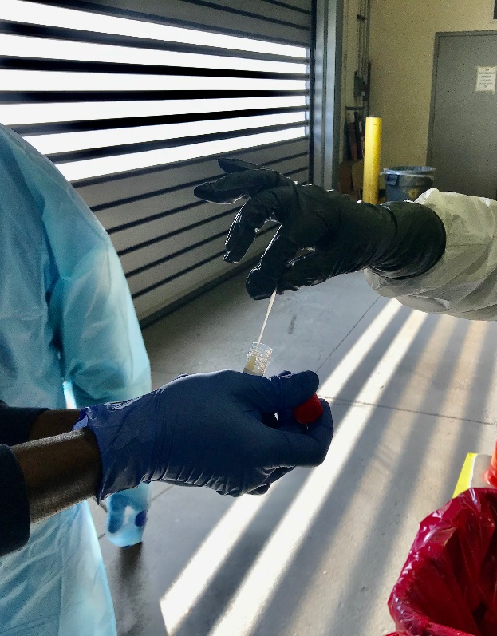
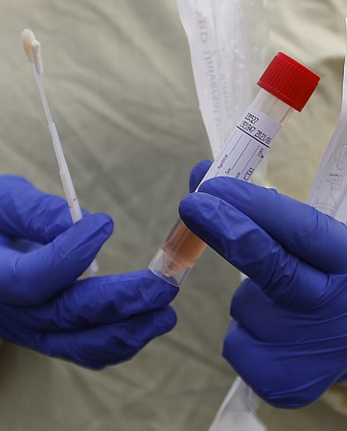
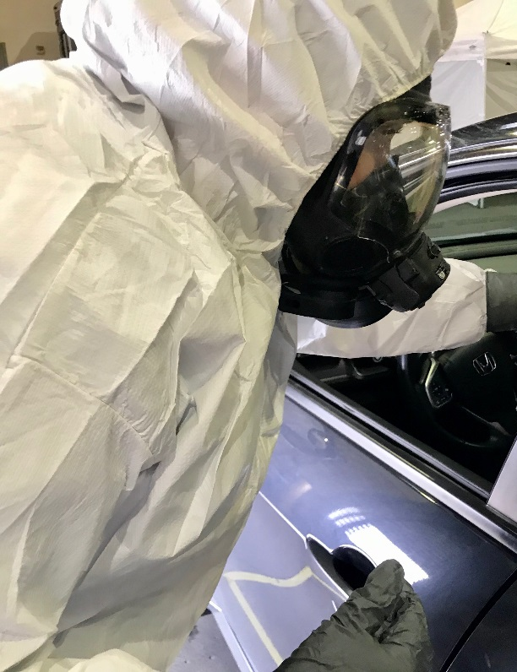
First Responder Testing Clinic

Slide 23
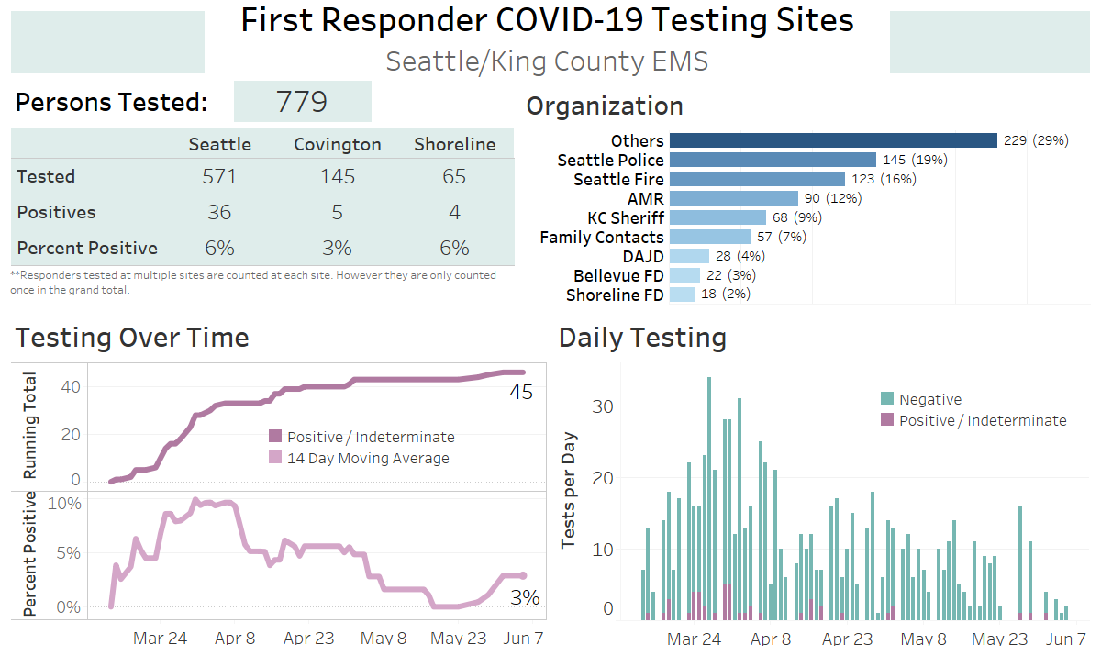

Slide 24
System Monitoring

Slide 25
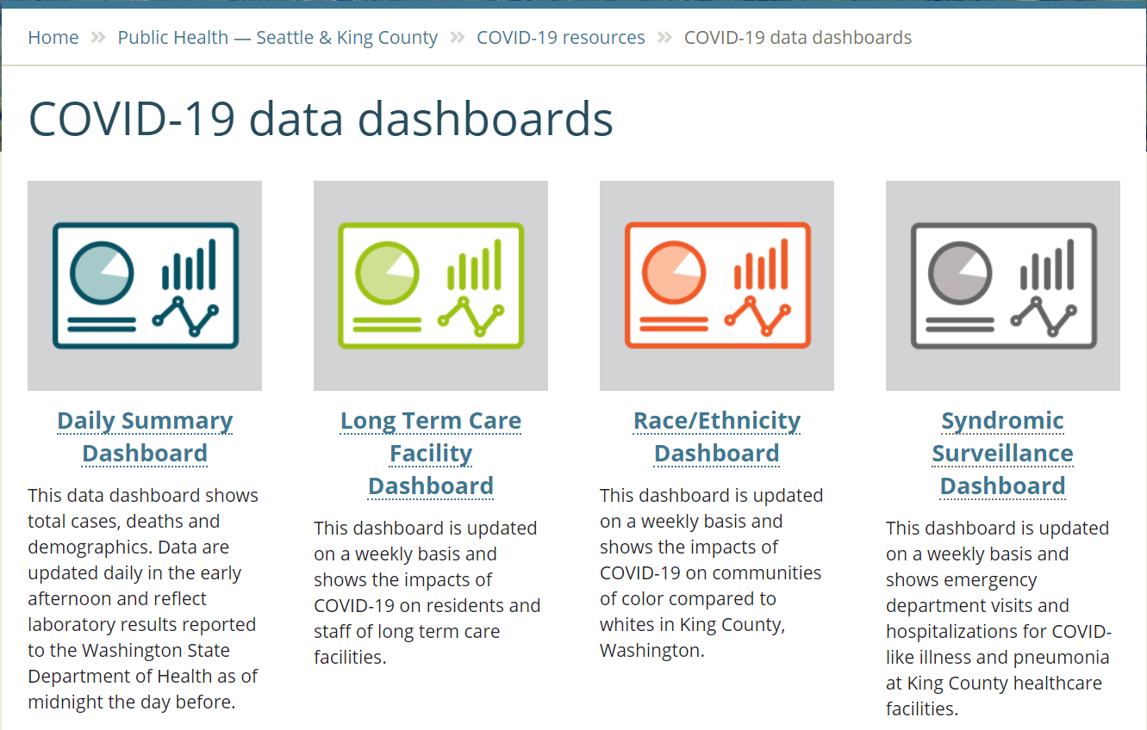
System Monitoring
https://www.kingcounty.gov/depts/health/covid-19/data.aspx

Slide 26

Cardiac Arrest Resuscitation

Slide 27
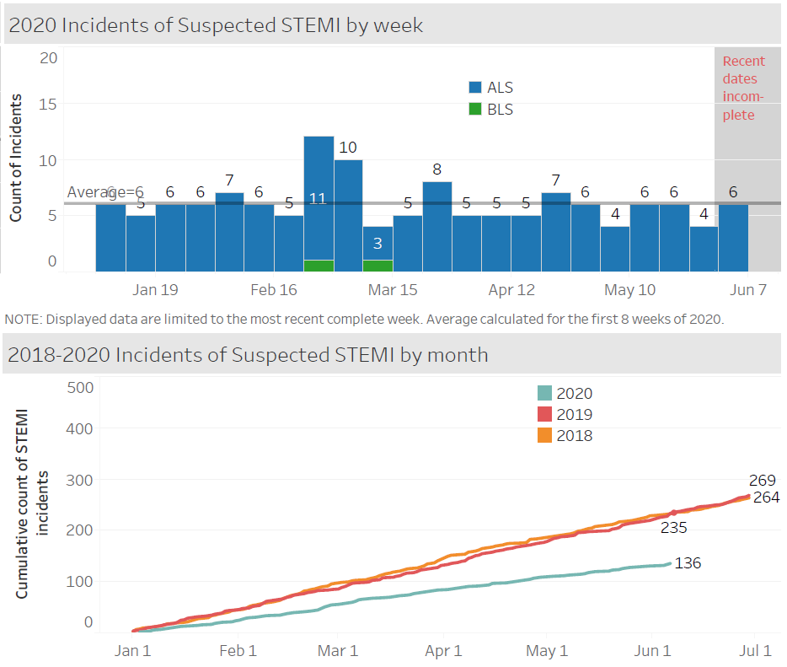
EMS-Assessed STEMI

Slide 28
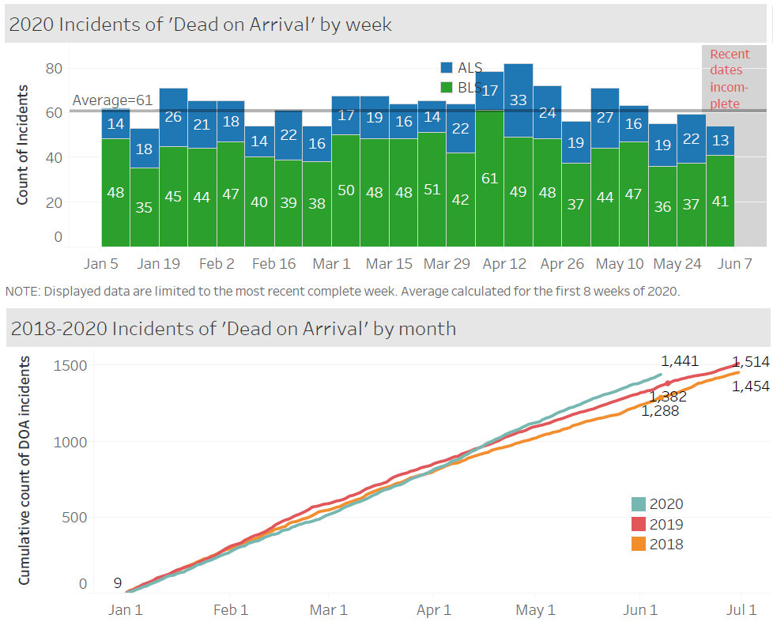
Dead on EMS Arrival

Slide 29
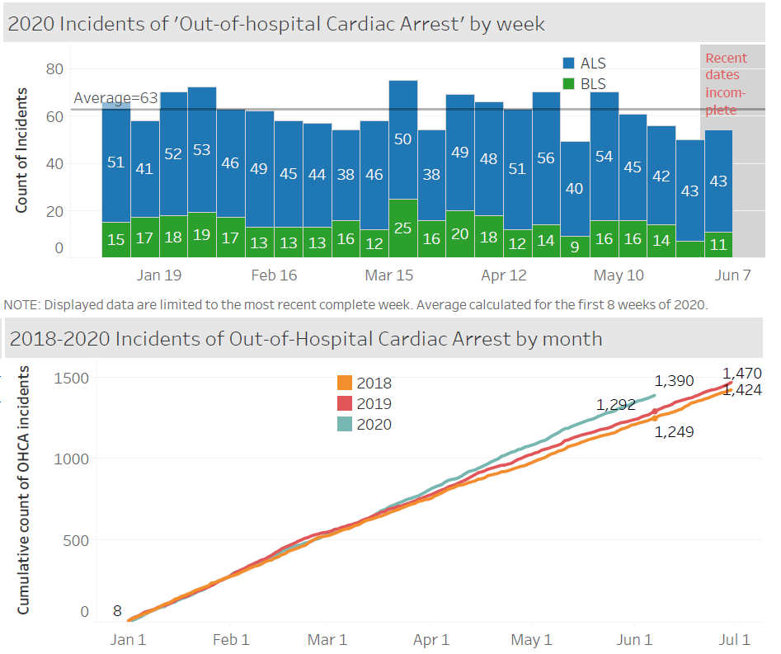
EMS-Treated Cardiac Arrest

Slide 30

Cardiac Arrest Resuscitation

Slide 31
Cardiac Arrest Resuscitation: Focus on the Bystander
Bystander CPR improves the likelihood of survival, which decreases with every minute that CPR is delayed.
Telecommunicators should screen for COVID-19 symptoms, known COVID infection, or recent COVID contact.
Face masks covering the mouth and nose of rescuer and/or patient may reduce transmission risk.

Slide 32
Cardiac Arrest Resuscitation
Bystander CPR improves the likelihood of survival, which decreases with every minute that CPR is delayed.
Telecommunicators should screen for COVID-19 symptoms, known COVID infection, or recent COVID contact.
Delay, Delay, Delay
Face masks covering the mouth and nose of rescuer and/or patient may reduce transmission risk.

Slide 33
Citizen CPR: Balance of Risk & Benefit?
Risks (Rescuer)
Benefits (Patient)
Prevalence of COVID-19 among OHCA? _?_
Risk of (new) transmission (CC only)? _?_
Risk of death once infected w/COVID - ~1-2%
NNT to save 1 life ~33

Slide 34
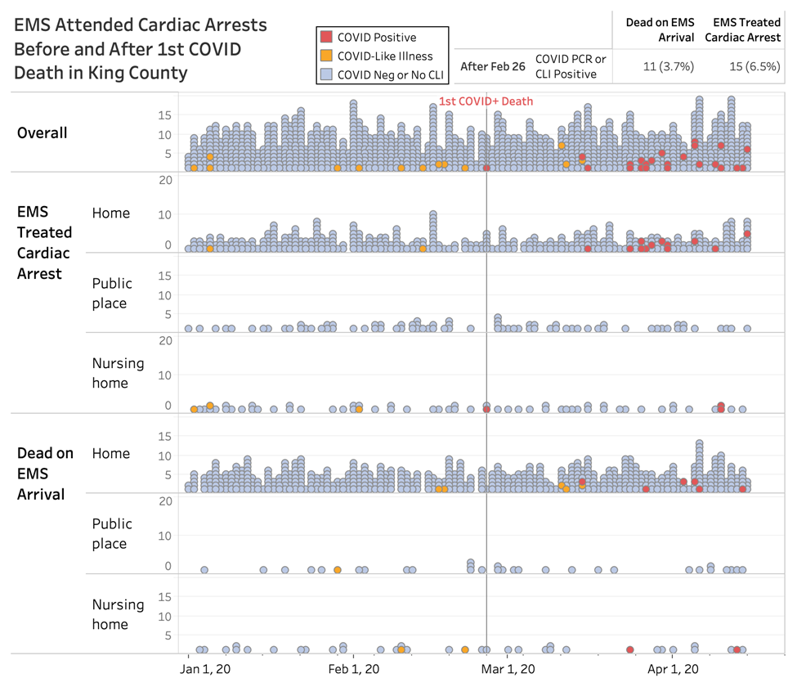
What is COVID prevalence among OHCA patients?
Circulation Study Figure

Slide 35
Best Approach for Citizen CPR?
Risks (Rescuer)
Benefits (Patient)
Prevalence of COVID-19 among OHCA? <10%
Risk of (new) transmission (CC only)? ?10%?_
Risk of death once infected w/COVID - ~1-2%
NNT to save 1 life ~33
NNT for 1 death = 5,000-10,000
NNT to save 1 life ~33
1 death for every 150-300 lives saved

Slide 36

No Change: Telecommunicator Questions & Direction
Patient conscious?......No
Patient breathing normally?.....No
“We need to start CPR. I can help you.”

Slide 37
Outline
1. In the beginning…..first few days
2. Critical structure and strategies
3. Healthcare worker safety
4. Monitoring the system
5. Resuscitation

Slide 38
Seattle and King County, WA COVID-19
Thomas Rea MD MPH
University of Washington
May 20, 2020

