Slide 1
SaveMiHeart Conference
2019 Progress Report
Robert W. Neumar, MD, PhD
President, SaveMiHeart
Chair, Department of Emergency Medicine
University of Michigan
@neumar_robert
neumar@umich.edu
Doubling Cardiac Arrest Survival by 2020
June 12th, 2020

Slide 2
Disclosures
Co-Chair: International Liaison Committee on Resuscitation (ILCOR)
President and Board Chair, SaveMiHeart
Past Chair, American Heart Association Emergency Cardiovascular Care Committee (AHA-ECC)
NIH and AHA Research Funding
PhysioControl: Equipment support for research
June 12th 2020

Slide 3
Save 1 extra life every day
Doubling Cardiac Arrest Survival
in Michigan by 2020
June 12th 2020

Slide 4
System of Care for Out-of-Hospital Cardiac Arrest
Bystander Response
911 Dispatch
EMS
Hospital
Kronick Circulation 2015
June 12th 2020

Slide 5
Michigan CARES 2018 Summary Report
June 12th 2020

Slide 6
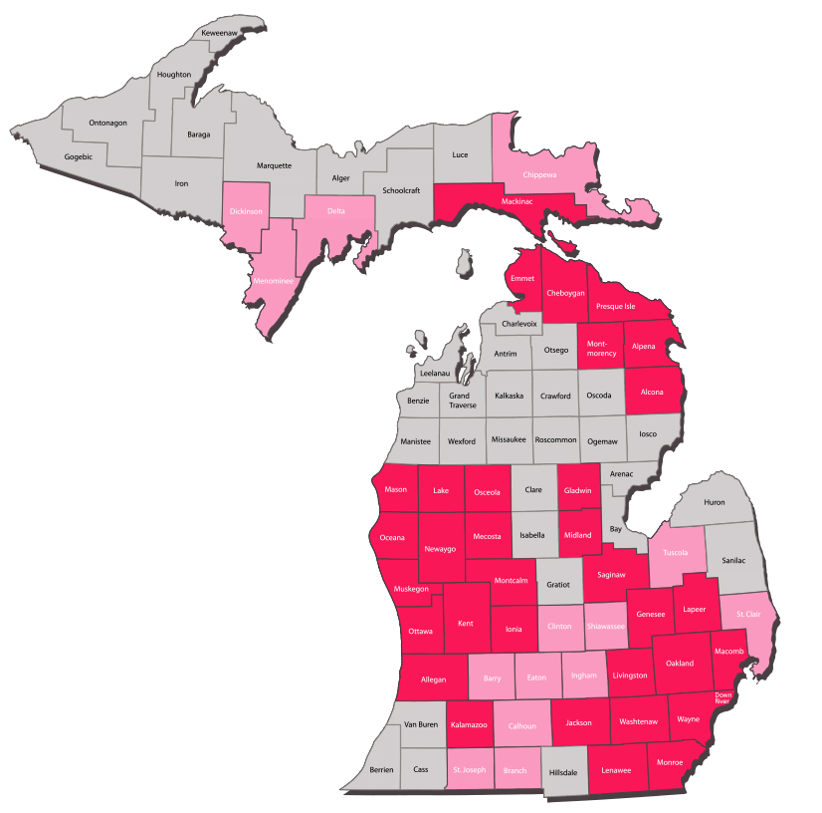
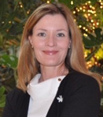
Michigan CARES 2019
151 EMS Agencies
Michigan Population: 9.9 million
CARES Population: 9.2 million
Percent Covered: 93%
Treated arrests: 7,727
Treated incidence: 84/100,000
116 Hospitals
Teri Shields
State Coordinator
June 12,2020

Slide 7
2019 MI Bystander CPR: 43.4% (Increased from 36.7% in 2014)
Bystander CPR Rate
June 12th 2020

Slide 8
2019 MI Bystander AED Applied: 9.8% (Increased from 6.3% in 2014)
Bystander AED Applied Rate
June 12th 2020

Slide 9
2019 MI Return of Spontaneous Circulation: 29.7% (Increased from 26.3% in 2014)
ROSC Rate
June 12th 2020

Slide 10
2019 MI Survival to Hospital Discharge: 8.7% (Increased from 7.9% in 2014)
Survival Rate
June 12th 2020

Slide 11
2019 MI Survival with Good Neurologic Function: 7.1% (Increased from 6.2% in 2014)
Survival with Good Neurologic Function Rate (CPC 1or 2)
June 12th 2020

Slide 12
2018 MI In-Hospital Mortality: 66.5% (Increased from 66.2% in 2014)
In-Hospital Mortality Rate
June 12th 2020

Slide 13
Michigan Chain of Survival
June 12th 2020

Slide 14
SaveMiHeart Dashboard: 2019
Only 1 year left to reach goal by 2020
June 12th 2020

Slide 15
SaveMiHeart Impact: 2019
549 Survivors with Good Neurologic Function
33 more that in 2018
June 12th 2020

Slide 16
System of Care for Out-of-Hospital Cardiac Arrest
Bystander Response
911 Dispatch
EMS
Hospital
Kronick Circulation 2015
June 12th 2020

Slide 17
Variability in Overall Survival
5
Range 2% to 22%
SaveMiHeart Goal 15.8%
National overall survival rate = 10.5%
Inclusion criteria: out-of-hospital cardiac arrests of non-traumatic etiology where resuscitation was attempted by a 911 responder (CPR and/or defibrillation). This includes patients that received an AED shock by a bystander prior to the arrival of 911 responders.

Slide 18
Variability in Bystander CPR
7
Range 4% to 73%
SaveMiHeart Goal 55%
National bystander CPR rate = 41.2%
Inclusion criteria: out-of-hospital cardiac arrests of non-traumatic etiology where resuscitation was attempted by a 911 responder (CPR and/or defibrillation). This includes patients that received an AED shock by a bystander prior to the arrival of 911 responders. These rates exclude arrests that were witnessed by a 911 Responder or occurred in a nursing home/healthcare facility.

Slide 19
Variability in Sustained ROSC
8
Range 5% to 49%
SaveMiHeart Goal 37%
National Sustained ROSC rate = 30.7%
Inclusion criteria: out-of-hospital cardiac arrests of non-traumatic etiology where resuscitation was attempted by a 911 responder (CPR and/or defibrillation). This includes patients that received an AED shock by a bystander prior to the arrival of 911 responders.
Notes:
ROSC is defined as the restoration of a palpable pulse or a measurable blood pressure (for 20 minutes consecutive minutes).

Slide 20
Variability in Hospital Hypothermia
Range 6% to 75%
National in-hospital hypothermia rate = 45.8%
Inclusion criteria: out-of-hospital cardiac arrests of non-traumatic etiology where resuscitation was attempted by a 911 responder (CPR and/or defibrillation). This includes patients that received an AED shock by a bystander prior to the arrival of 911 responders. *Among admitted patients

Slide 21
Variability in Coronary Angiography
Range 1% to 37%
National Coronary Angiography rate = 16.2%
Inclusion criteria: out-of-hospital cardiac arrests of non-traumatic etiology where resuscitation was attempted by a 911 responder (CPR and/or defibrillation). This includes patients that received an AED shock by a bystander prior to the arrival of 911 responders. * This includes only those calls with completed hospital data. The analysis is limited to questions with Yes or No response only (unknown and missing excluded).

Slide 22
Variability in Hospital Mortality
10
Range 31% to 93%
SaveMiHeart Goal 55%
National in-hospital mortality rate = 62.3%
Inclusion criteria: Inclusion criteria: out-of-hospital cardiac arrests of non-traumatic etiology where resuscitation was attempted by a 911 responder (CPR and/or defibrillation). This includes patients that received an AED shock by a bystander prior to the arrival of 911 responders. *Among admitted patients.
Notes:
This includes the out-of-hospital cardiac arrest patients that survived to hospital admission but did not survive to hospital discharge.

Slide 23
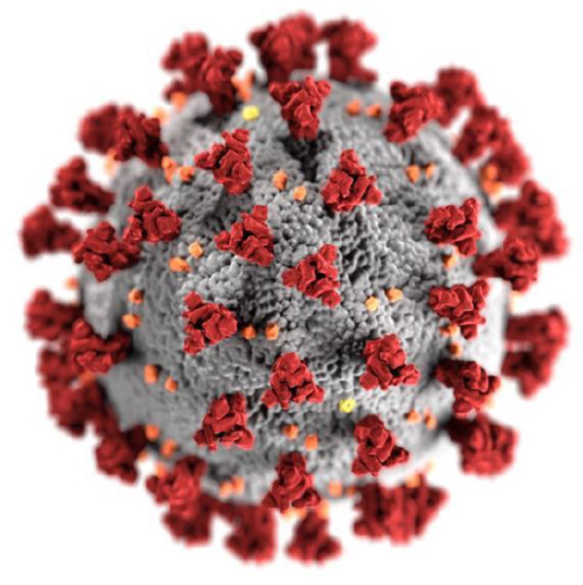
COVID-19
June 12th 2020

Slide 24
COVID-19 IMPACT Preliminary CARES data February to April of 2020
• Shockable presenting rhythms decreasing (17.5 % to 14.4%)
• Public location of arrests decreasing (17.9% to 11.7%)
• Bystander AED Application in Public location decreasing (13.7% to 9.7%)
• Bystander CPR without significant change (40.1% to 40.3 %)
• Field Termination of Resuscitation (TOR) rate increasing (37.9% to 49.3%)
Message from the CARES Advisory Council 5/11/2020
June 12th 2020

Slide 25
Save 1 extra life every day
June 12th 2020

