Slide 1
The impact of COVID-19 on State EMS protocols
William Fales, MD
State Medical Director
MDHHS Division of EMS and Trauma

Slide 2
Disclosures and Conflicts
Disclosures
Michigan Department of Health and Human Services
State Medical Director, Division of EMS and Trauma
Western Michigan University Homer Stryker MD School of Medicine
Professor and Chief, Division of EMS and Disaster Medicine
Kalamazoo County Medical Control Authority
EMS Medical Director
SaveMIHeart
Board of Directors
Conflicts
None to report

Slide 3
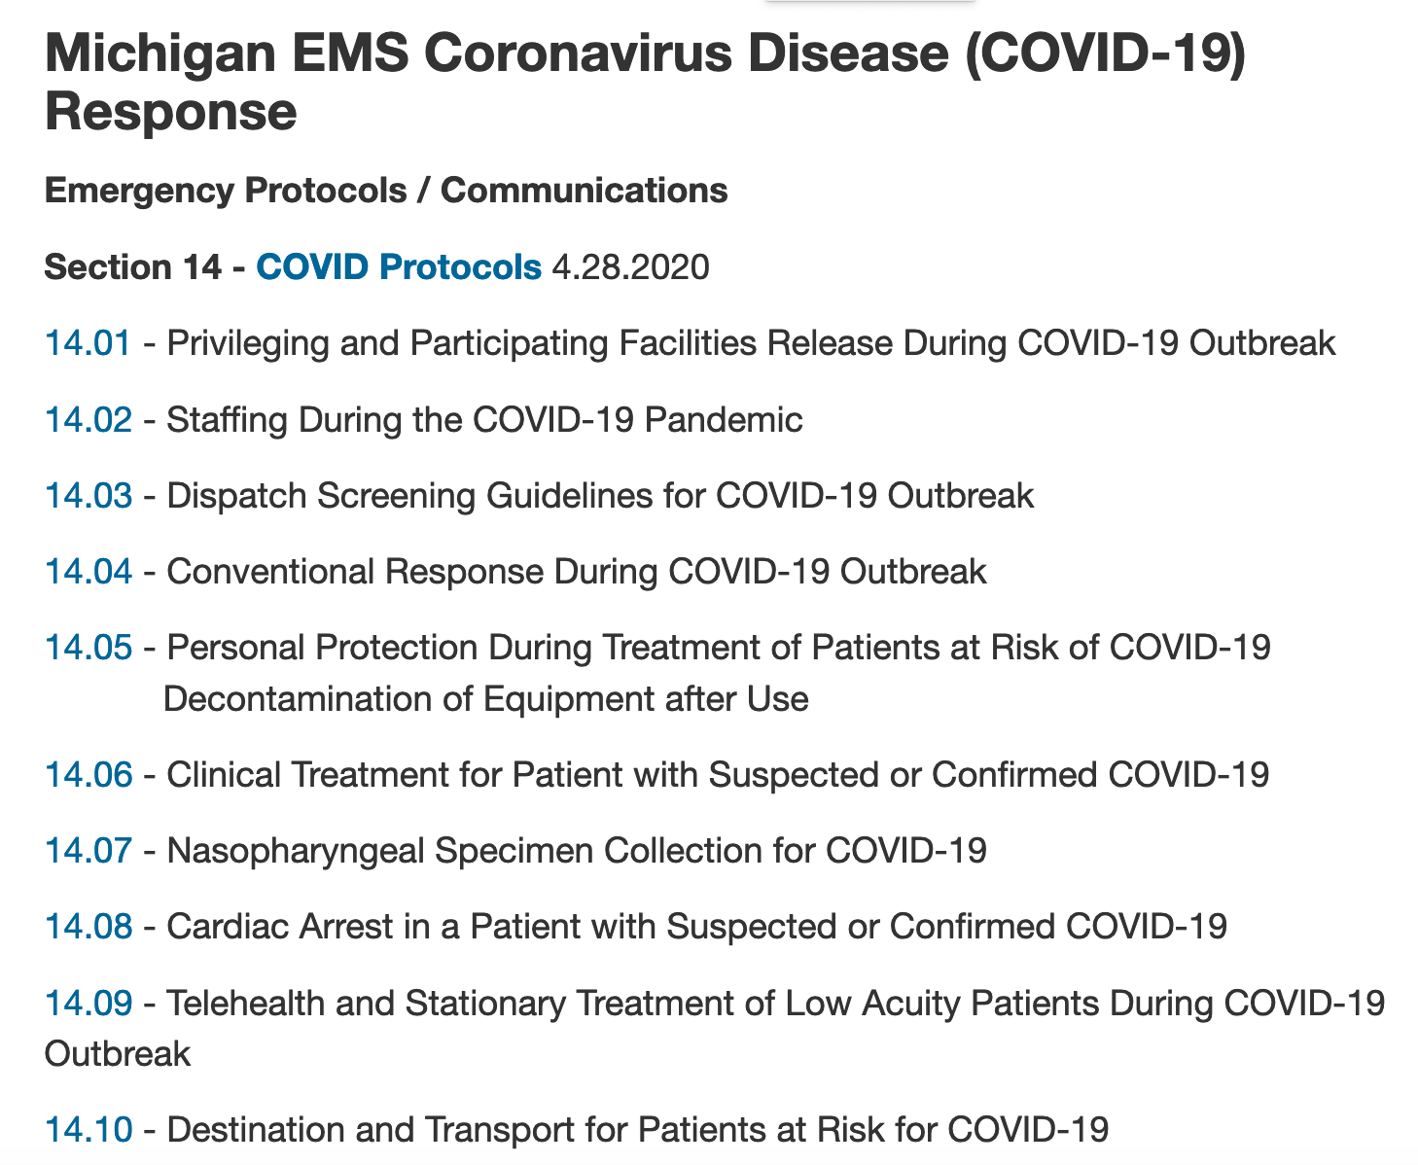
Michigan EMS Coronavirus Disease (COVID-19) Response
www.Michigan.gov/EMS

Slide 4
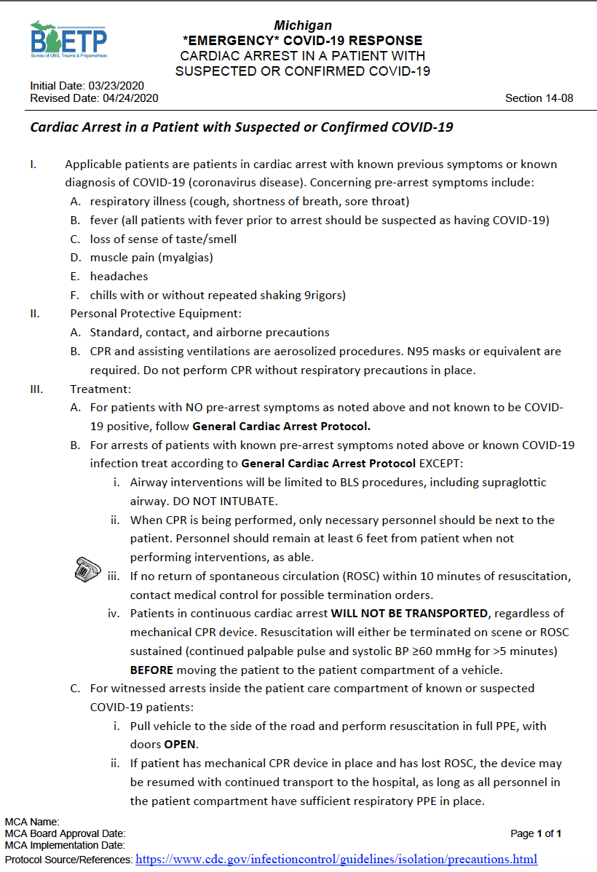
CARDIAC ARREST IN A PATIENT WITH SUSPECTED OR CONFIRMED COVID-19
Applicable patients are patients in cardiac arrest with known previous symptoms or known diagnosis of COVID-19. Concerning pre-arrest symptoms include:
A. respiratory illness (cough, shortness of breath, sore throat)
B. fever (all patients with fever prior to arrest should be suspected as having COVID-19)
C. loss of sense of taste/smell
D. muscle pain (myalgias)
E. headaches
F. chills with or without repeated shaking (rigors)
Have a low threshold to suspect COVID-19

Slide 5
CARDIAC ARREST IN A PATIENT WITH SUSPECTED OR CONFIRMED COVID-19
Personal Protective Equipment:
A. Standard, contact, and airborne precautions
B. CPR and assisting ventilations are aerosolized procedures. N95 masks or equivalent are required. Do not perform CPR without respiratory precautions in place.
Practical Consideration: From a PPE perspective, approach all sudden cardiac arrest patients as if they have COVID-19.

Slide 6
CARDIAC ARREST IN A PATIENT WITH SUSPECTED OR CONFIRMED COVID-19
Treatment:
For patients with NO pre-arrest symptoms as noted above and not known to be COVID-19 positive, follow General Cardiac Arrest Protocol.

Slide 7
CARDIAC ARREST IN A PATIENT WITH SUSPECTED OR CONFIRMED COVID-19
Treatment:
B. For arrests of patients with known pre-arrest symptoms noted above or known COVID-19 infection treat according to General Cardiac Arrest Protocol EXCEPT:
Airway: BLS interventions (including SGA)-NO INTUBATION
CPR: Limit to necessary personnel – Keep 6-foot distance, as able
If no ROSC within 10 minutes of resuscitation, contact medical control for possible termination orders.
Do not transport patients remaining in cardiac arrest
Before moving the patient to the ambulance
Must have sustained ROSC (continued palpable pulse and systolic BP ≥60 mmHg for >5 minutes)
Otherwise field termination, even if mechanical CPR available

Slide 8
CARDIAC ARREST IN A PATIENT WITH SUSPECTED OR CONFIRMED COVID-19
Treatment:
C. For witnessed arrests inside the patient care compartment of known or suspected COVID-19 patients:
Pull vehicle to the side of the road and perform resuscitation in full PPE, with doors OPEN.
If patient has mechanical CPR device in place and has lost ROSC, the device may be resumed with continued transport to the hospital
All personnel in the patient compartment have sufficient respiratory PPE in place.

Slide 9
Preliminary Data Analysis
Source: Michigan EMS Information System (MI-EMSIS)
Analyzed via Biospatial
WARNING: Not CARES! (“Dirty Data”)
Michigan EMS has experienced a decline in volume during the pandemic of 25 to >40%!

Slide 10
Statewide Non-Traumatic Cardiac Arrests March to May 2019 vs 2020 – Source MI-EMSIS (Biospatial)
250/wk
43.1% Increase
250/wk

Slide 11
Statewide Non-Traumatic Arrests March to May 2019 vs 2020 – Source MI-EMSIS (Biospatial)
2
0
1
9
2
0
2
0
38%
47%
34%
31%
10%
8%
59%
38%
33%
10%
12%
5%

Slide 12
Statewide Shockable Arrests, Presumed Cardiac Etiology March to May 2019 vs 2020 – Source MI-EMSIS (Biospatial)
25/wk
14.8% Increase
37.1% Increase
25/wk

Slide 13
Statewide Shockable Arrests, Presumed Cardiac Etiology March to May 2019 vs 2020 – Source MI-EMSIS (Biospatial)
2
0
1
9
2
0
2
0
71%
51%
31%
24%
17% (28%)
11%
55%
71%
33%
14%
16% (29%)
10%

Slide 14
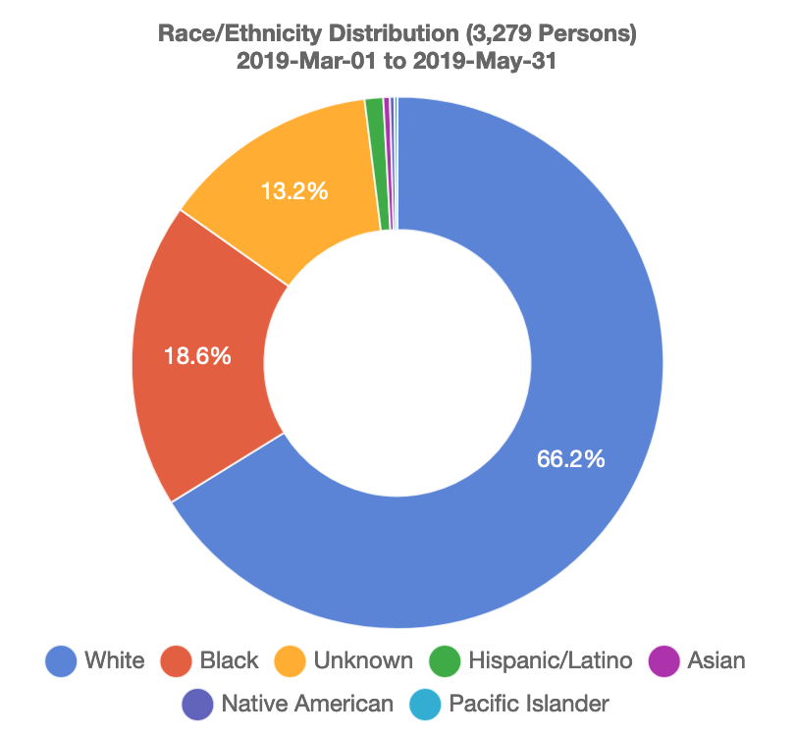
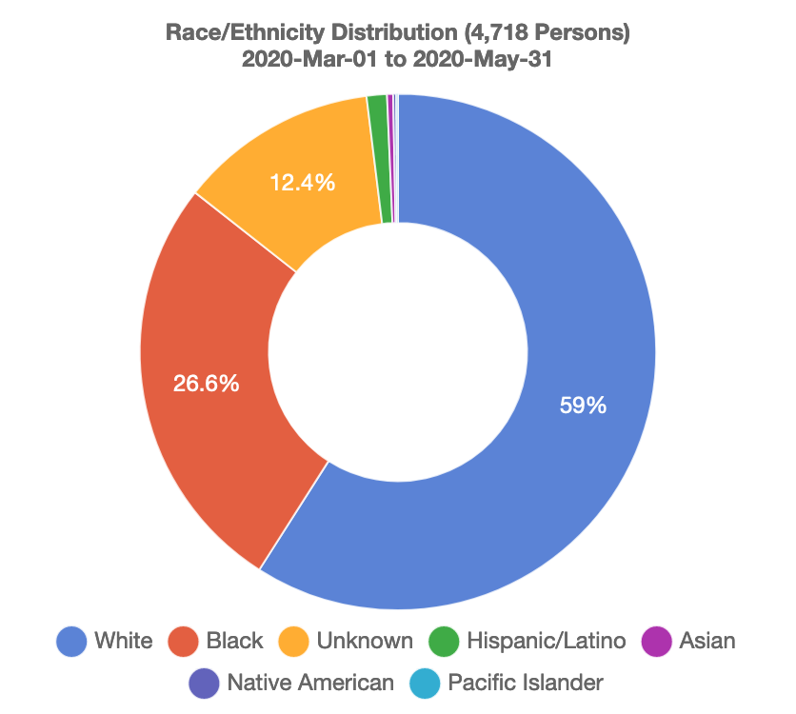
Cardiac Arrest by Race March to May 2019 vs 2020
2
0
1
9
2
0
2
0

Slide 15
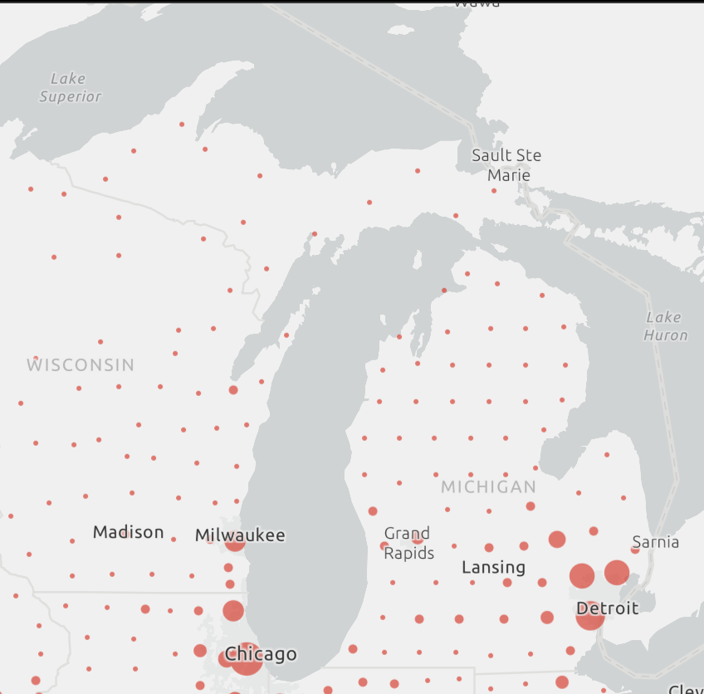
Michigan COVID-19
First 2 cases – March 10
Asymmetric epidemiology
SE Michigan – Extreme Activity
Rest of Michigan – Sporadic Activity
Comparable to other states
Extreme conditions in SE MI
Peak hospitalizations: >4,400
12-days with >1000 on ventilation
1,223 on ventilation on one day
Peak intubations in 1 day: 176
Source: John Hopkins Coronavirus Resource Center (Retrieved 4/21/2020)

Slide 16
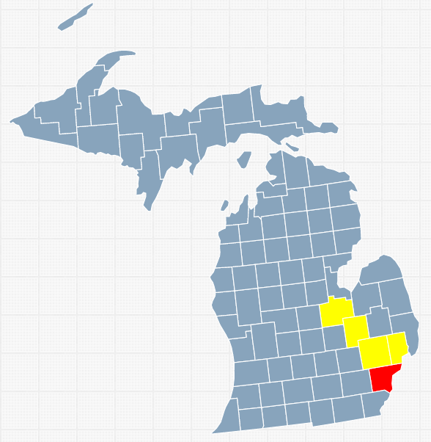
Michigan COVID-19 High Impact Counties
Counties with Death Rate Greater than Statewide Death Rate (57.8/100K)
Wayne County (66.4/100K)
City of Detroit (224.3/100K)
Oakland County (84.3/100K)
Macomb County (100.6/100K)
Genesee County (69.7/100K)
Saginaw County (61.6/100K)
Population 4.5 million
45% of state population
Source: MDHHS Bureau of Epidemiology

Slide 17
High impact Counties – All Non-Traumatic Arrests March to May 2019 vs 2020 – Source MI-EMSIS (Biospatial)
120/wk
61.4% Increase
120/wk

Slide 18
High impact Counties – All Non-Traumatic Arrests March to May 2019 vs 2020 – Source MI-EMSIS (Biospatial)
2
0
1
9
2
0
2
0
36%
33%
42%
30%
13%
5% (32%)
58%
35%
33%
12%
9%
3% (30%)

Slide 19
High impact Counties - Shockable Arrests March to May 2019 vs 2020 – Source MI-EMSIS (Biospatial)
15/wk
21.7% Increase
40.5% Increase
15/wk

Slide 20
High impact Counties - Shockable Arrests March to May 2019 vs 2020 – Source MI-EMSIS (Biospatial)
2
0
1
9
2
0
2
0
74%
46%
32%
15%
13%
10%
69%
44%
35%
9%
11%
7%

Slide 21
Data Summary
Cardiac arrests reported by EMS during 3-month period 2020 vs 2019
Increased statewide by 43.1%
Increased in high impact counties by 61.4%
Overall similar with bystander witnessed, CPR, AED use
Except decline in bystander AED use in high impact counties in shockable rhythms
Arrests with shockable rhythms and cardiac etiology increased
Statewide 14.8%
High impact counties 21.7%
Intubations were decreased statewide and in high impact counties.
Field Terminations increased decreased statewide and in high impact counties.
ROSC data were limited in quality.

Slide 22
Considerations
During a pandemic more people die
Causes of Death?
COVID-19? vs. Non-COVID-19
Acute MI, PE, Respiratory, OD
EMS system response?
Need for better crisis communication with public?

Slide 23
Thank You
Questions?
falews@michigan.gov

